Slide 1
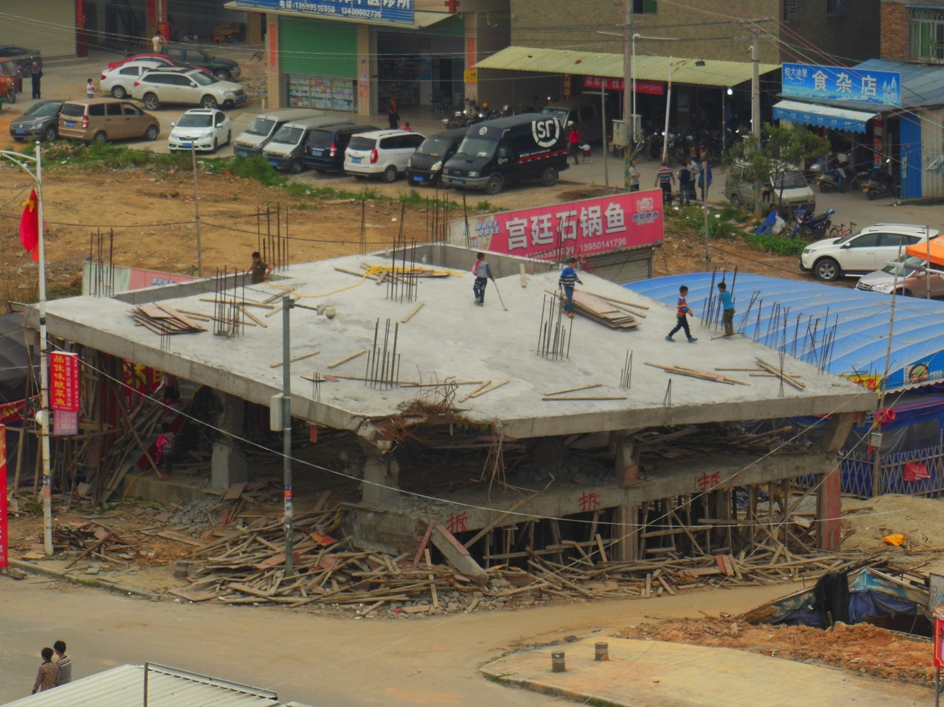

Slide 2

Teaching Kids to Create and Publish Online
John Larkin
Mantle Conference 2015
The Hunter
Edited Presentation: Imagery of students engaged in clasroom activities removed

Slide 3
Me
Recently retired teacher.
Presenter and trainer.
www.larkin.net.au

Slide 4
So…
Creating, writing and publishing… and do not forget the audio, imagery and video!

Slide 5
Why write?
Develop communication skills
Remember
Formative growth
Creativity
Self-understanding

Slide 6
Why write?
Promotes attention and focus
Improves long-term memory
Reveals patterns
Reveals gaps in knowledge

Slide 7
Why write?
“Consistently, one of the largest differences between failing and successful students was that only the latter could express their thoughts on the page.”
Deirdre DeAngelis, Principal, New Dorp Public High School, USA.

Slide 8
Why write?
“Stories have the felicitous capacity of capturing exactly those elements that formal decision methods leave out.”
Stories capture the context, capture the emotions… Stories are important cognitive events, for they encapsulate, into one compact package, information, knowledge, context and emotion.
It is high concept and high touch
Don Norman, Things That Make Us Smart

Slide 9
Why write?
Narrative imagining is the fundamental instrument of thought
“ Rational capacities depend on it. It is our chief means of predicting, of planning, and of explaining… Most of our experiences, our knowledge and our thinking is organised as stories.”
Mark Turner, The Literary Mind

Slide 10
Why write stories?
Stories are easier to remember, facts not so…
Stories are how we remember
In this information age facts are free and ubiquitous… we need to turn them into stories
Enrich the facts with a story and deliver them in context and deliver them with emotion
  A Whole New Mind, Daniel H. Pink

Slide 11
Why publish?
Interact
Wider audience
Think about knowledge & skills differently
Reconceptualise current knowledge & skills
Develop literacy skills using a different medium
Develop confidence

Slide 12
Before writing & publishing
Know and understand
Vocabulary
Text structures
Purpose
Who will read my writing?
Who will view my creative output?

Slide 13
Before writing
Brainstorming ~ concept maps
Key words and phrases
Organising information (field knowledge)
Note making ~ drafts
Scaffolds or frameworks
Peer review

Slide 14
Before publishing
Review the draft, if at all…
Gather the graphics and photographs
Organise links
Organise references

Slide 15
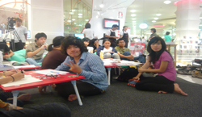



Where to write & publish?

Slide 16

New spaces

Slide 17
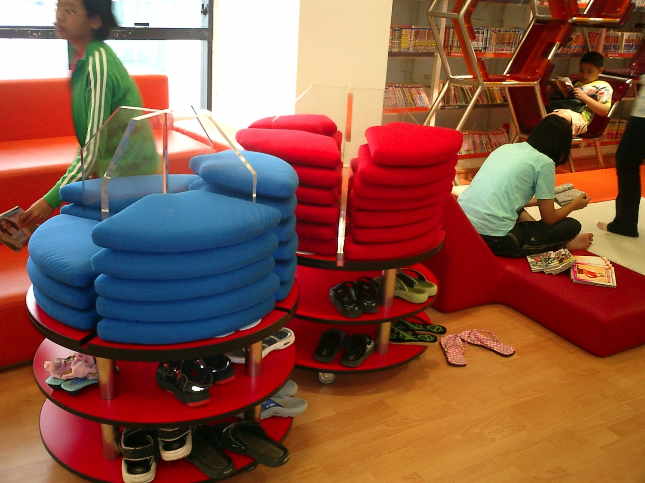
New spaces

Slide 18
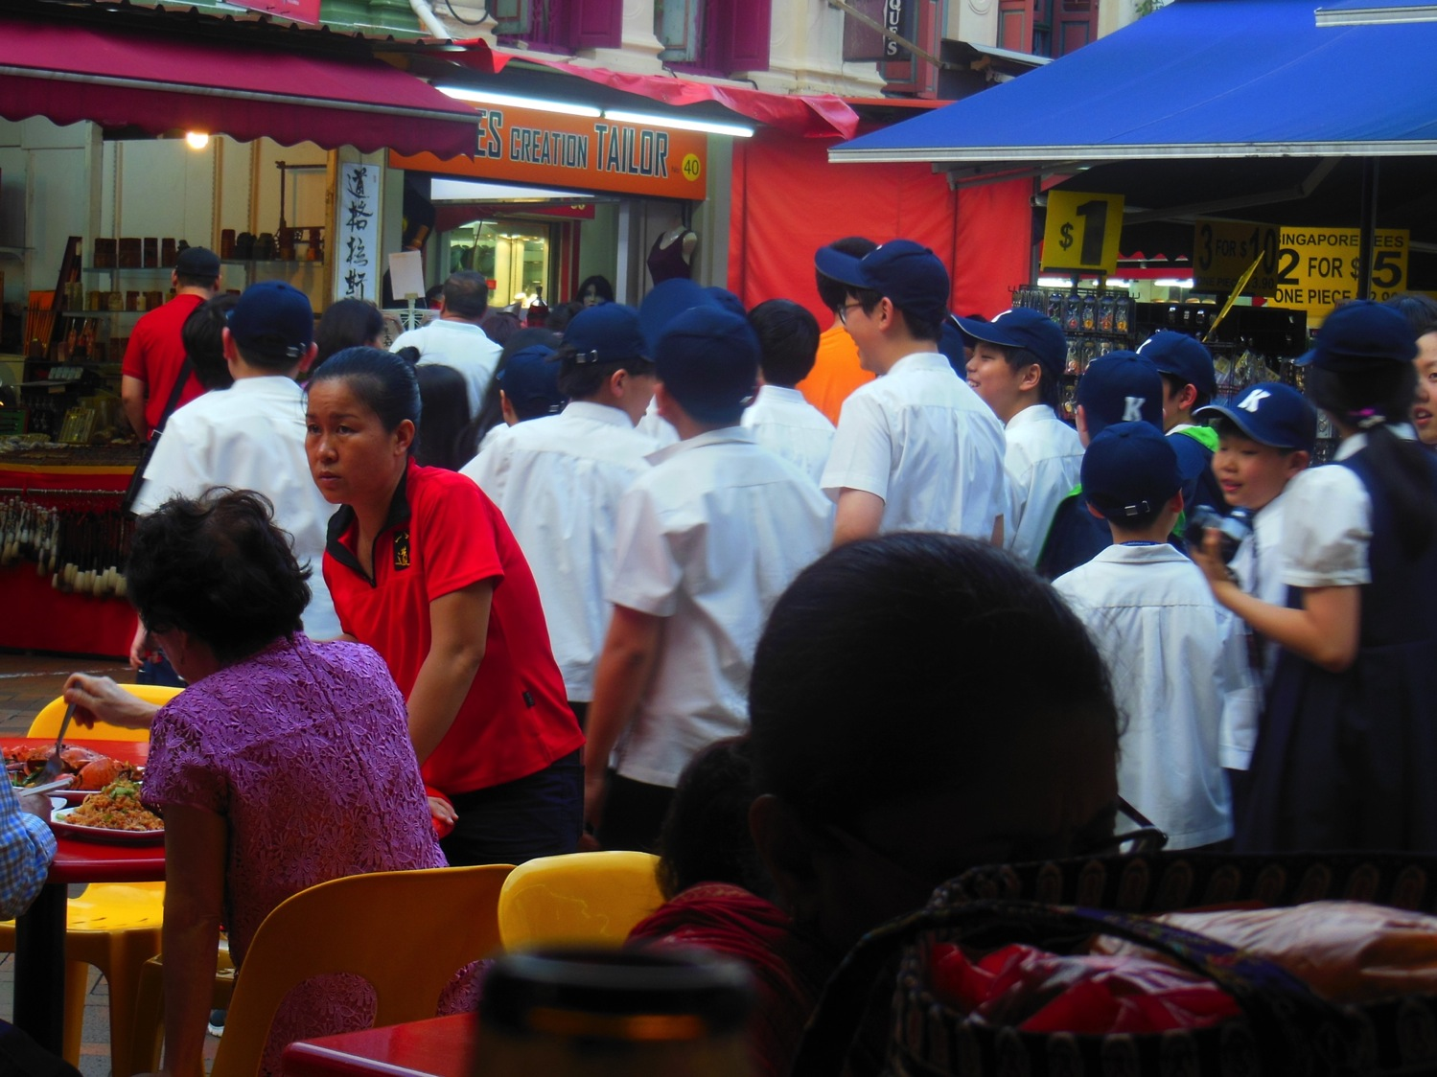

Slide 19


Slide 20
What can ignite writing & publishing?
Empathy
Influential people
Turning points
Happiness ~ Sadness
Passion
Intrigue
A Cause

Slide 21
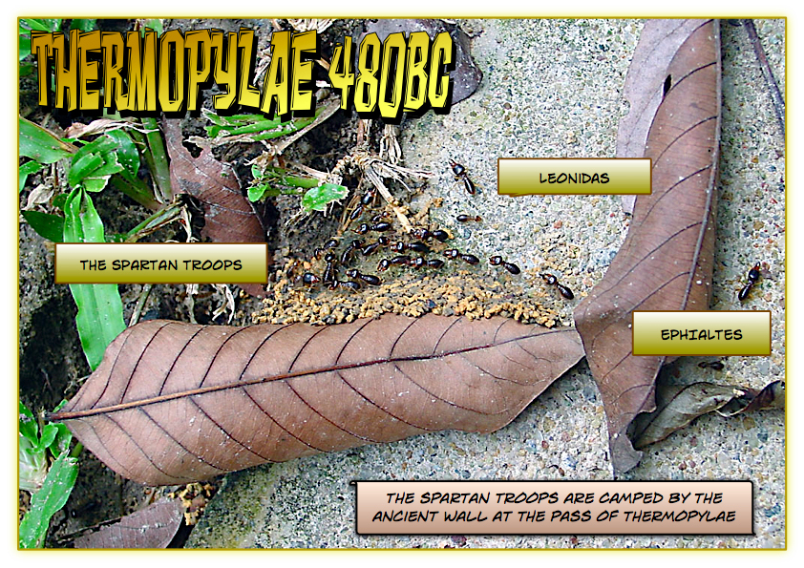

Slide 22
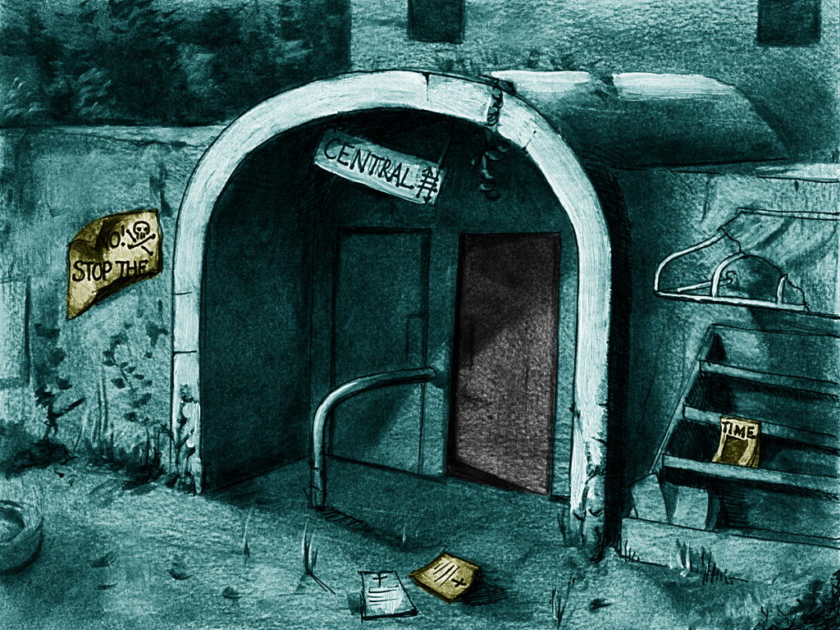

Slide 23
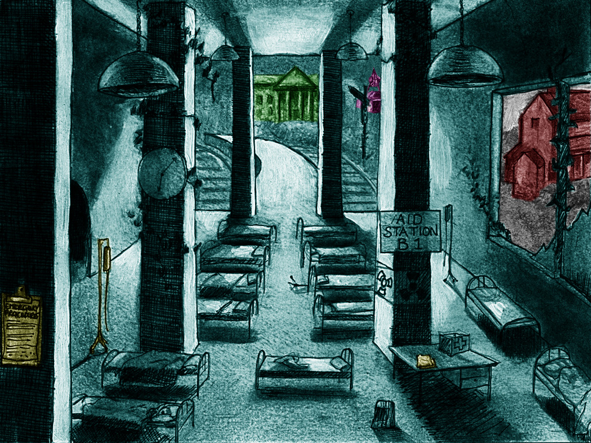

Slide 24
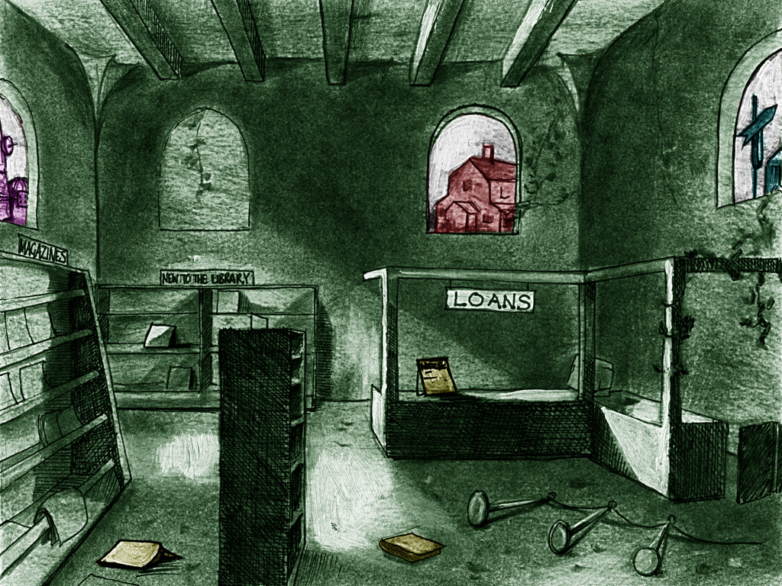

Slide 25

Attribution: Jeremy Barwick http://www.flickr.com/people/jeremybarwick/

Slide 26
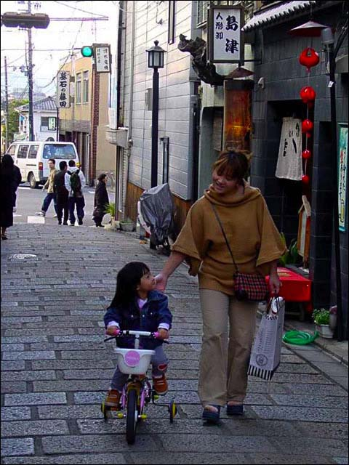

Slide 27


Slide 28
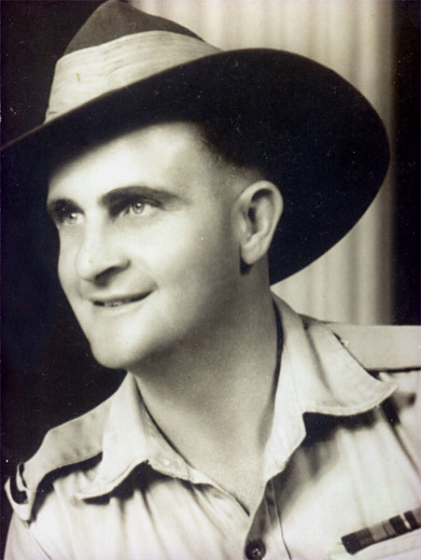
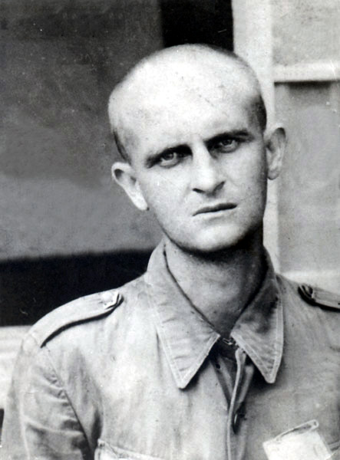

Slide 29
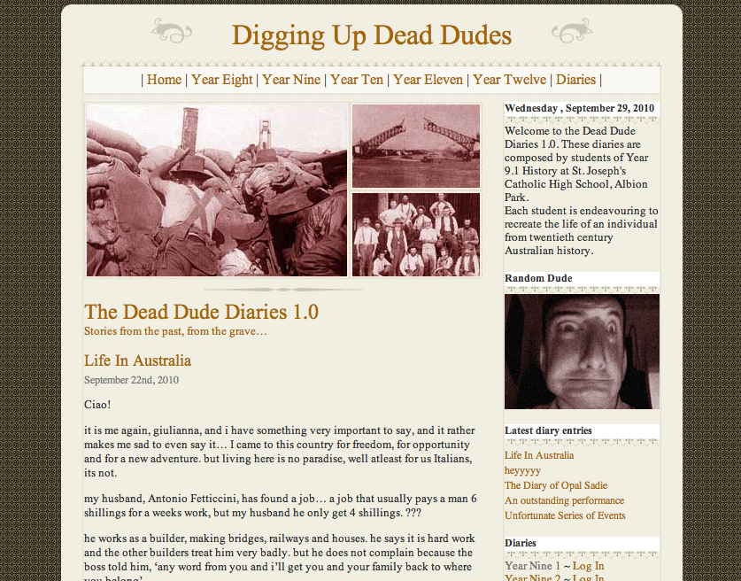

Slide 30


Slide 31


Slide 32
Engage with community
Bring in experts
Reach out to the community
  Volunteer work
  Guiding
  Sharing
  Wisdom

Slide 33
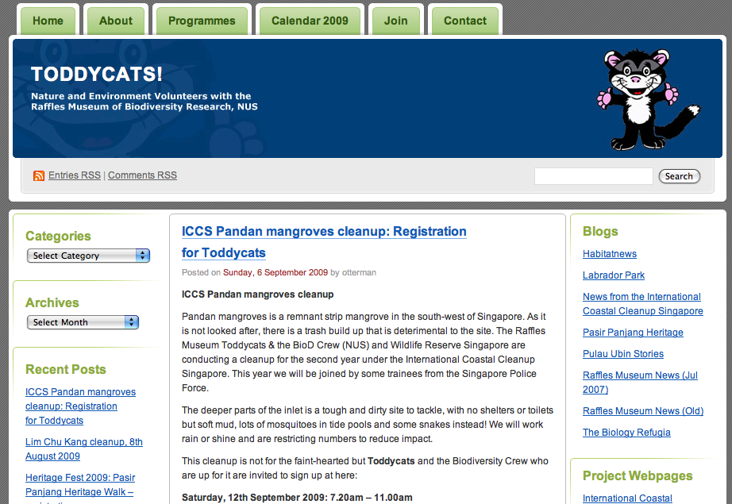

Slide 34
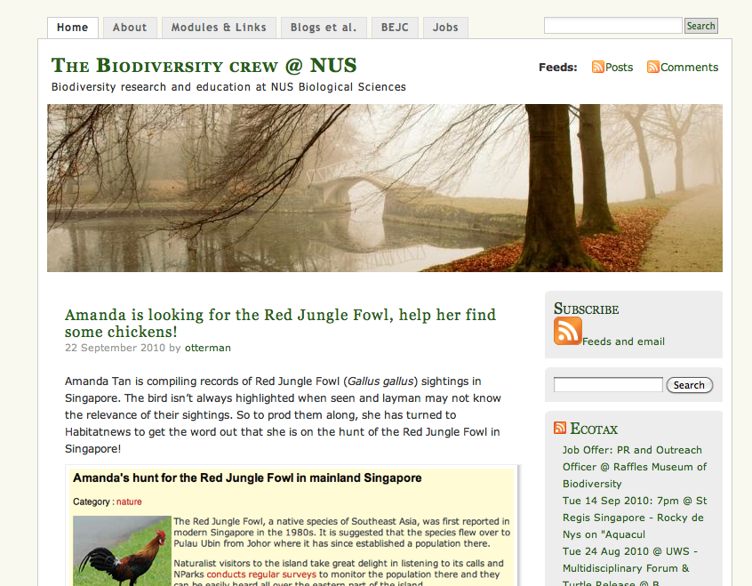

Slide 35


Slide 36
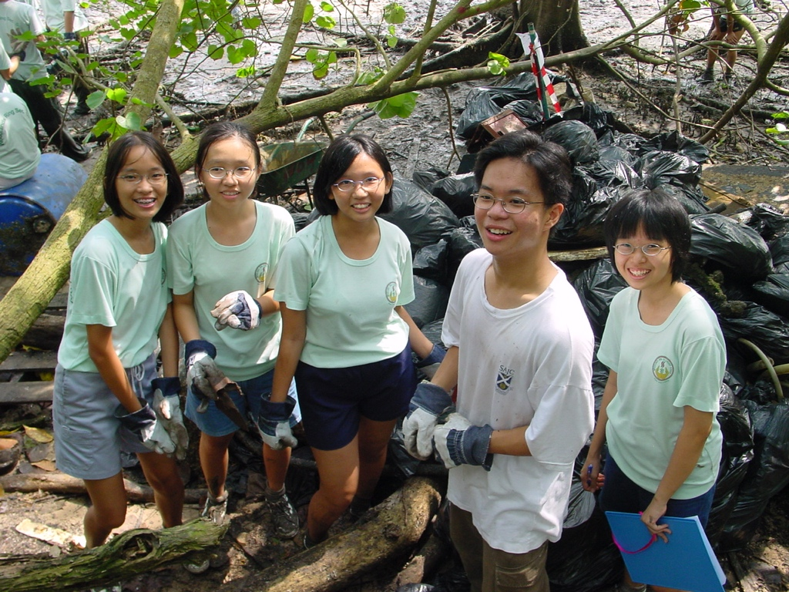

Slide 37
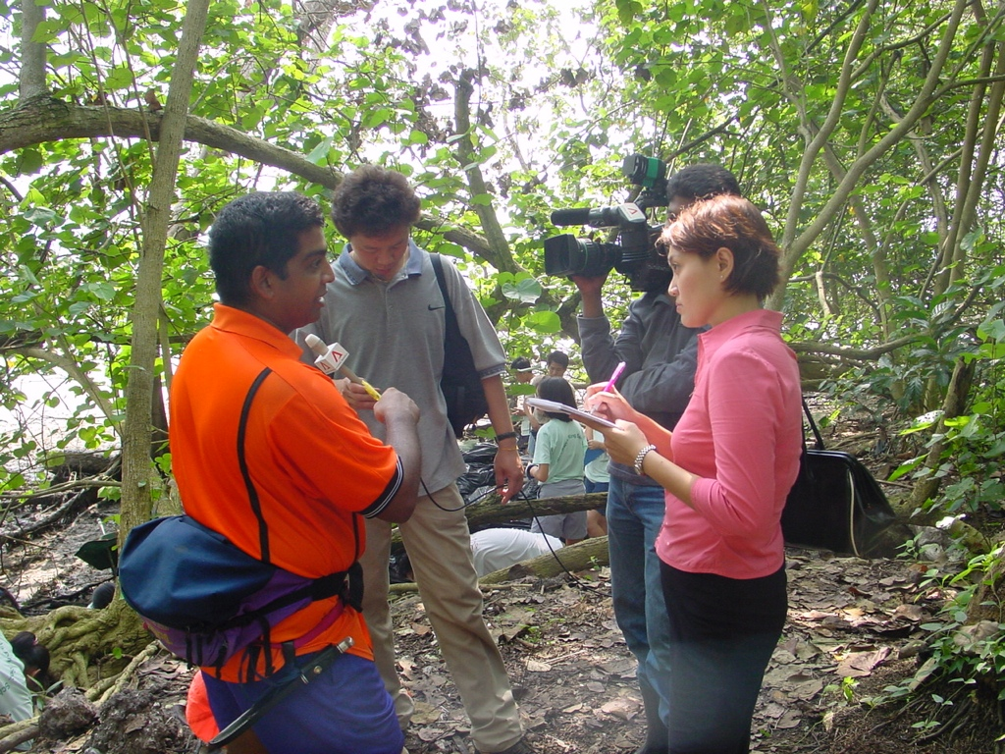

Slide 38
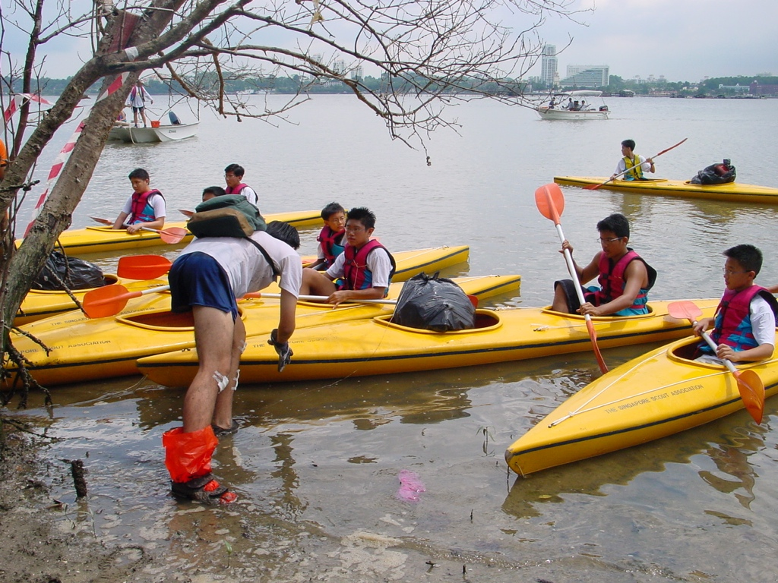

Slide 39
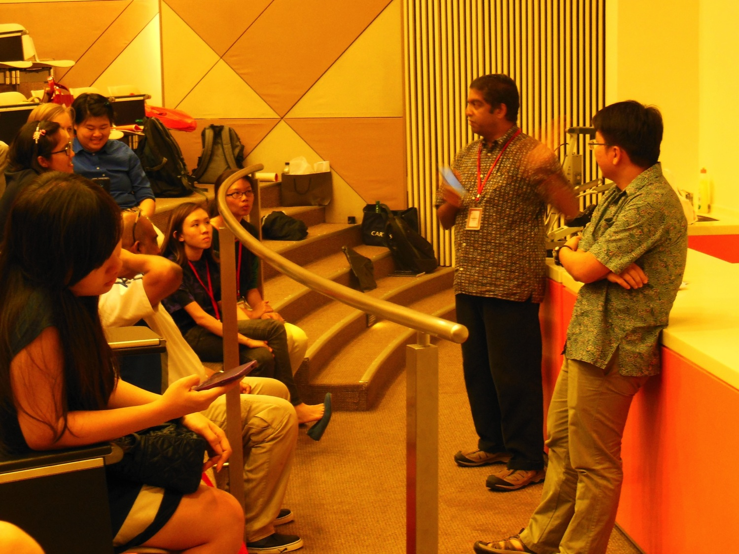

Slide 40
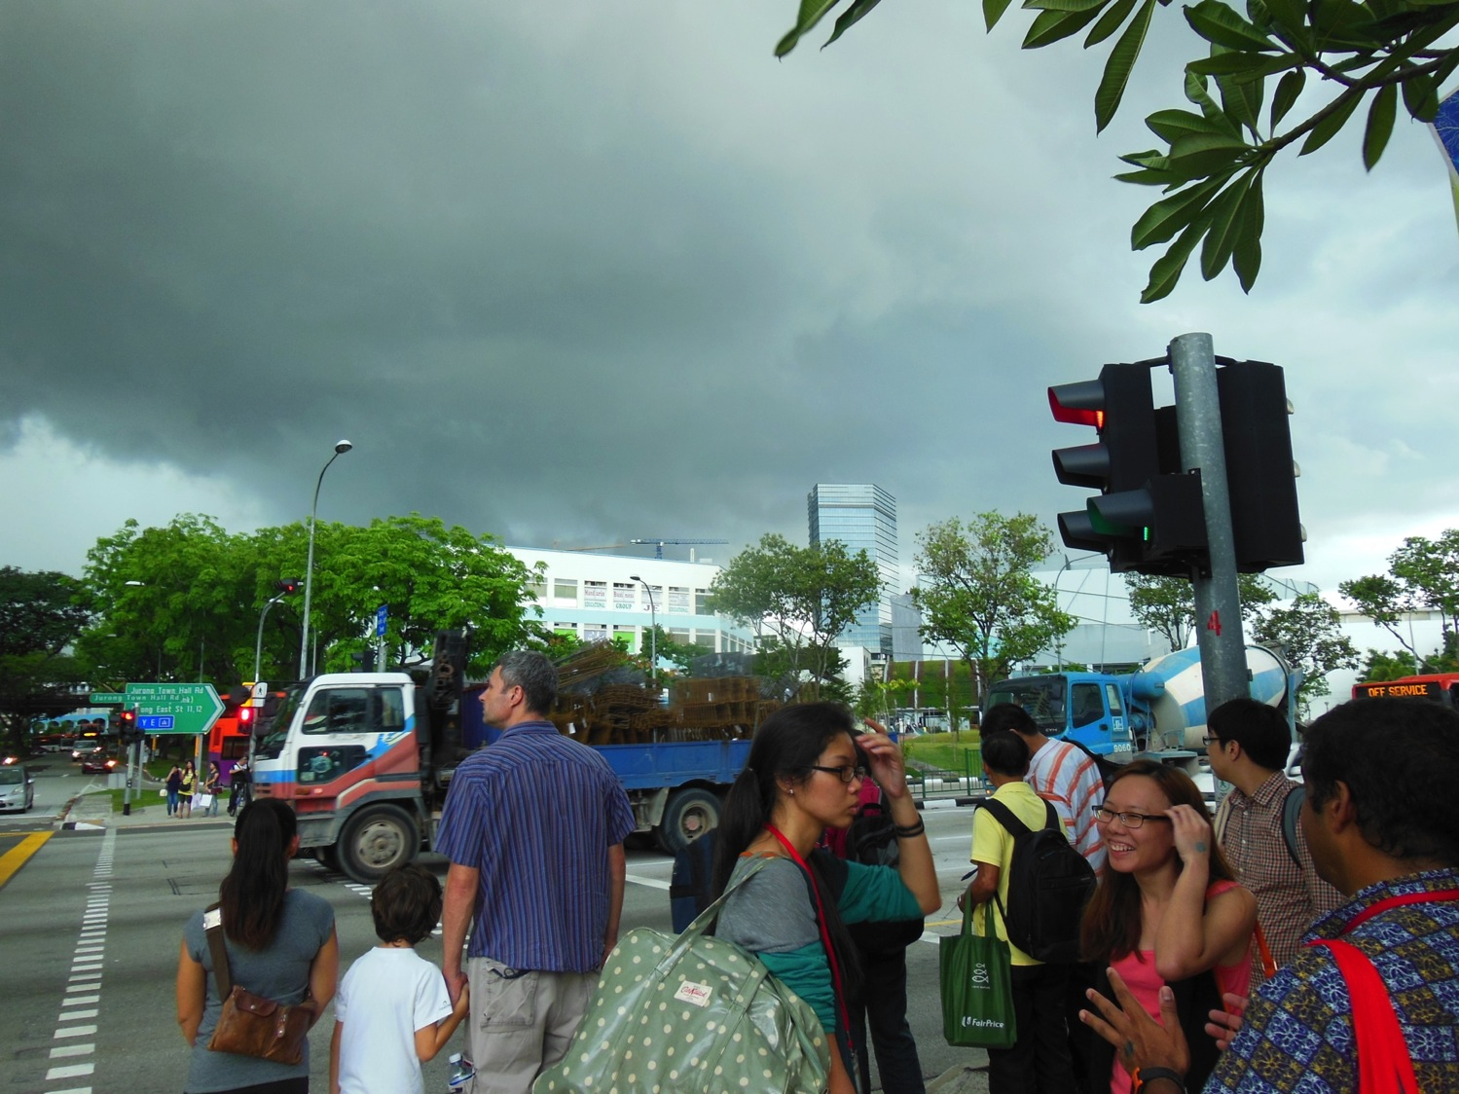

Slide 41
How can students benefit?
Understanding through piecing together the pieces of a newly discovered jigsaw puzzle
Collaboration, decision making and critical thinking
Taking ownership and exercising responsibility
Self-regulation and formative development
An opportunity to think about design, look & feel

Slide 42
How can students benefit?
Metacognition
Active Participation
Motivation
Develop skills favoured by employers
Multiple literacies: text, audio, imagery, video
Opportunities for formative feedback
A sophisticated digital footprint

Slide 43
Curriculum Ideas
Collaborations
Field reports
Journals
Weekly learning reviews
Personal Interest Projects
Process Reviews
DAT Reports

Slide 44
Curriculum Ideas
Old stories with new endings
Give the conclusion
Progressive stories
Poetry
Illustrated stories
Empathy journeys
Bizarre ideas

Slide 45
Curriculum Matrix

Slide 46
Curriculum Matrix
 | Lecture | Field Trip | Assessment | Technology
Knowledge
Skill
Attitude

Slide 47
Curriculum Matrix
 | Lecture | Field Trip | Assessment | Technology
Knowledge
Skill
Attitude

Slide 48
Curriculum Matrix
 | Lecture | Field Trip | Assessment | Technology
Knowledge
Skill
Attitude

Slide 49
Steps to take…
A topic that captures your imagination and passion
A tool that clicks for you and with which you feel comfortable
A simple integration and implementation path
A sane time of the year

Slide 50
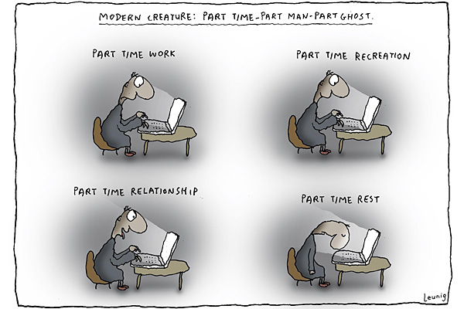
Remember…

Slide 51
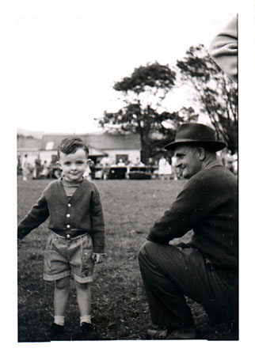
Conclusion and thank you
John Larkin
john@larkin.net.au
www.larkin.net.au

